Slide 1
Wellness Re-imagined: for Students and Educators of Ghana
Presenters
Braimah Peter Manasseh SISO/STEM District Officer, Saboba
Elizabeth Brown-Davis Ed.S NBCT

Slide 2
Overview
Introduction
Quantitative Study
Key Findings
Conclusions and Recommendations
Building Culture
Breathing Technique

Slide 3
State of Wellness Among Students and Educators in the North East Region of Ghana
Authored By:
Braimah Peter Manasseh
SISO/STEM District Officer, Saboba.

Slide 4
Background/Context
Wellness in educational settings is increasingly being recognised as a fundamental contributor to academic success and personal well-being (Kaya & Erdem, 2021).
The term wellness, encompasses several dimensions, including physical, mental, emotional, social, and academic wellness (Hargreaves & Shirley, 2021; Kaya & Erdem, 2021; Wortham et al., 2020).
Each of these dimensions plays a crucial role in shaping the general health and satisfaction of students and educators.
Globally, there has been a growing acknowledgement of the importance of holistic wellness programmes in schools.
These programmes are designed to address various stressors that can affect the ability to learn and teach effectively (Amholt et al., 2020).

Slide 5
Background/Context
Studies have suggested that comprehensive wellness initiatives can lead to improved student concentration, lower absenteeism, and reduced teacher turnover (Hargreaves & Shirley, 2021; Kaya & Erdem, 2021; Wortham et al., 2020).
Successful examples from countries with robust wellness programmes highlight the integration of physical activities, mental health support, and social-emotional learning into the daily curriculum and activities.
In Ghana, the concept of wellness within is still evolving.
While some schools may have begun to implement structured wellness programmes, others are lagging behind.
Evidence from the literature suggests that disparities can be attributed to factors such as limited resources, lack of awareness, and insufficient training for staff on the importance of wellness (Hargreaves & Shirley, 2021; Kaya & Erdem, 2021; Wortham et al., 2020).

Slide 6
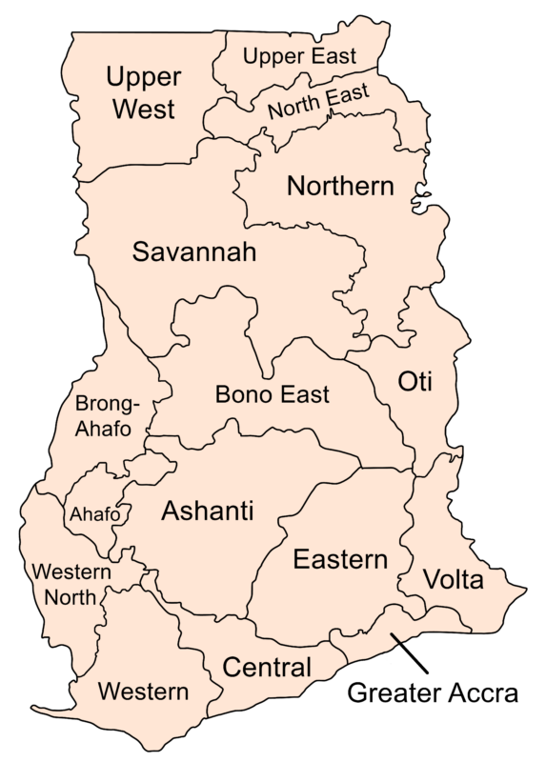
Background/Context
The Northern regions of Ghana, characterised by their diverse cultural backgrounds and varying economic conditions, presents unique challenges and opportunities for implementing wellness programmes.
Having been an educator in the Northern Region of Ghana for several decades, my review of the literature and reports reveals that there is no empirical data on the wellness of students and educators in the North East Region of Ghana and the whole northern belt at large.
This gap highlights the need to assess current wellness practices and to identify the factors that enhance or impede their effective implementation within the region's schools.

Slide 7
Research Questions
What are the current wellness practices available to students and educators in the North East Region of Ghana?
What factors contribute to or hinder wellness practices among students and educators in the North East Region of Ghana?

Slide 8
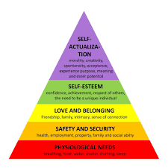
Theoretical Framework
The study was underpinned by Abraham Maslow's Theory of Needs

Slide 9
Theoretical Framework
Questions on:
physical wellness addressed physiological needs.
mental wellness addressed safety needs.
emotional wellness addressed both safety and esteem needs.
social wellness addressed love and belonging needs.
academic wellness addressed self-actualisation needs.

Slide 10
Key Findings
“… Lack of portable drinking water …”, “Some teachers are suffering from chronic liver disease which they don't have the funds to Carter for …” (Respondent S12, T4)
RQ1 - What are the current wellness practices available to students and educators in the North East Region of Ghana?
A
N
Mean Score Range | Interpretation
1.00 - 1.49 | Strongly Disagree =SD
1.50 - 2.49 | Disagree=D
2.50 - 3.49 | Neutral =N
3.50 - 4.49 | Agree =A
4.50 - 5.00 | Strongly Agree =SA
A
N
D
N
D
N
D
N
D
D
Notes:
Opportunities for Physical Activity: Both teachers and students generally agree that there are opportunities to participate in physical activities, with mean scores of 3.72 (teachers) and 3.54 (students), indicating agreement.
Access to Nutritious Meals: There is a notable lack of access to nutritious meals during school hours, with mean scores of 2.49 (teachers) and 2.45 (students), indicating disagreement.
Regular Health Education: Both groups disagree on receiving regular health education, with mean scores of 2.92 (teachers) and 2.68 (students).
Periodic Health Screenings: There is a significant lack of periodic health screenings, as indicated by the low mean scores of 2.38 (teachers) and 2.09 (students).
Health Emergency Measures: Measures to handle health emergencies are perceived to be inadequate, with mean scores of 2.65 (teachers) and 2.09 (students).
Overall School Environment: The school environment is moderately well organized according to students (mean score of 3.01), but teachers are neutral (mean score of 2.98).

Slide 11
Key Findings
“… Staying in the rural areas are not easy … feeding, transportation and the environmental conditions [are] making teachers to have a lot of mental health issue…” (Respondent T6)
Mean Score Range | Interpretation
1.00 - 1.49 | Strongly Disagree =SD
1.50 - 2.49 | Disagree=D
2.50 - 3.49 | Neutral =N
3.50 - 4.49 | Agree =A
4.50 - 5.00 | Strongly Agree =SA
N
N
N
N
N
N
N
D
Notes:
Access to Counselling Services: Teachers (mean score of 2.30) and students (mean score of 2.69) largely indicated that they do not have adequate access to counselling services.
Manageability of Workload: Both teachers (mean score of 3.07) and students (mean score of 3.16) reported that the workload is somewhat manageable, but it still poses stress that affects their mental health.
Promotion of Mental Health Awareness: Teachers (mean score of 2.70) and students (mean score of 2.83) indicated that schools are not sufficiently promoting mental health awareness.
Comfort in Seeking Help for Mental Health Issues: Teachers (mean score of 3.06) and students (mean score of 3.07) feel moderately comfortable seeking help for mental health issues, but there is still room for improvement to reduce stigma and improve access to mental health resources.
Generally: The results indicate that there is inadequate access to counselling services, insufficient promotion of mental health awareness, and a moderate comfort level in seeking help for mental health issues among both teachers and students in the North East Region of Ghana, with the workload being somewhat manageable but still stressful.

Slide 12
Key Findings
Mean Score Range | Interpretation
1.00 - 1.49 | Strongly Disagree =SD
1.50 - 2.49 | Disagree=D
2.50 - 3.49 | Neutral =N
3.50 - 4.49 | Agree =A
4.50 - 5.00 | Strongly Agree =SA
A
A
N
N
N
N
N
N
N
N
N
D
Notes:
Teachers (mean score of 2.58) and students (mean score of 2.33) both did not agree that they have sufficient access to resources or programs that help with emotional development, such as emotional intelligence training. This indicates a significant gap in emotional development support within the schools.
Regarding emotional safety, teachers generally agree (mean score of 3.51) that they feel emotionally safe to express themselves, whereas students are neutral (mean score of 3.23), suggesting that emotional safety is more robust for teachers than for students and highlighting an area needing improvement for student emotional safety.
Both teachers (mean score of 2.78) and students (mean score of 2.71) are neutral about having access to support when they experience emotional difficulties, pointing to a lack of readily available emotional support resources.
Teachers (mean score of 3.49) and students (mean score of 3.77) agree that the school environment fosters positive emotional interactions among students and staff, which is a positive aspect of emotional wellness in these schools.
However, when it comes to feeling confident in their ability to manage emotions effectively, teachers are neutral (mean score of 3.12) and students lean towards agreement (mean score of 3.20), indicating a mixed level of confidence in emotional management skills.
Lastly, teachers (mean score of 3.39) and students (mean score of 3.04) are neutral about regularly participating in activities that boost their emotional well-being.

Slide 13
Key Findings
“… disrespect from some juniors…”, We live as family…”, “We support each in our welfare…” (Respondent S8, T9, T16)
A
A
Mean Score Range | Interpretation
1.00 - 1.49 | Strongly Disagree =SD
1.50 - 2.49 | Disagree=D
2.50 - 3.49 | Neutral =N
3.50 - 4.49 | Agree =A
4.50 - 5.00 | Strongly Agree =SA
A
A
N
N
N
N
N
N
Notes:
Sense of Community:
Teachers feel a strong sense of community within the school, whereas students are neutral, indicating a need to strengthen the sense of community for students.
Trusting Relationships:
Teachers agree that they have trusting relationships with their colleagues, while students are neutral, suggesting that fostering trust among students may be beneficial.
Extracurricular Activities:
Teachers feel that schools offer sufficient extracurricular activities that help build social skills, but students are neutral, indicating that the availability or appeal of these activities may need improvement for students.
Inclusion and Respect:
Teachers feel included and respected by their peers, regardless of differences, but students are neutral, pointing to a potential need for more inclusive and respectful practices among students.
Social Events and Gatherings:
Both teachers and students are neutral about the frequency and effectiveness of social events and gatherings in promoting a sense of belonging, suggesting that these activities could be enhanced to better serve the school community.

Slide 14
Key Findings
“… The school lack a computer and science lab for practical illustration of concepts and skill leaning…” (Respondent T11)
A
A
N
Mean Score Range | Interpretation
1.00 - 1.49 | Strongly Disagree =SD
1.50 - 2.49 | Disagree=D
2.50 - 3.49 | Neutral =N
3.50 - 4.49 | Agree =A
4.50 - 5.00 | Strongly Agree =SA
N
N
N
N
N
N
D
Notes:
Teachers, with a mean score of 3.89, agree that the teaching methods used at their school enhance their learning experience, while students, with a mean score of 3.41, remain neutral. This discrepancy suggests that students may need more engaging and effective teaching strategies to feel similarly supported.
Regarding access to academic support services, teachers, with a mean score of 2.34, disagree that they have adequate access to necessary resources such as internet, computers, and library resources, whereas students, with a mean score of 2.95, are neutral. This indicates a significant gap in the availability and adequacy of academic support services, particularly from the perspective of teachers.
Both teachers and students are neutral about the effectiveness of feedback provided to help them improve academically, with mean scores of 3.24 and 3.36, respectively. This neutrality suggests that feedback mechanisms may need enhancement to be more impactful for both groups.
In terms of the academic environment being conducive to teaching and learning, teachers and students both perceive it as neutral, with mean scores of 3.13 and 3.22, respectively. This indicates room for improvement in creating a more supportive and effective academic environment.
Lastly, teachers, with a mean score of 3.67, agree that the school encourages and supports continuous academic improvement, while students, with a mean score of 3.32, are neutral. This suggests that students may not feel as supported or encouraged in their academic pursuits as teachers perceive, highlighting a potential disconnect that needs addressing.

Slide 15
Key Findings
RQ2 - What factors contribute to or hinder wellness practices among students and educators in the North East Region of Ghana?
“… I am the only teacher in my school …”, “Inadequate resources …”, “Some parents do not allow their wards to partake in some exercises to enhance [their] wellness”,
“… Ignorance about wellness” (Respondent T3, T15, T5, T10)
Factors | Rankings
 | Teachers | Students
Resource Availability | 1st | 1st
Cultural and Community Influence | 2nd | 2nd
Training and Professional Development | 3rd | 4th
Staff and Administrative Support | 4th | 6th
Student and Educator Engagement | 5th | 3rd
Policy and Curriculum Integration | 6th | 5th
Notes:
The findings indicate that resource availability and cultural and community influence are the most significant factors contributing to or hindering wellness practices among students and educators in the North East Region of Ghana.
Both teachers and students rank resource availability as the top factor, followed by cultural and community influence.
Training and professional development, staff and administrative support, student and educator engagement, and policy and curriculum integration are also important, though they are ranked differently by teachers and students.

Slide 16
Conclusions & Recommendations
The lack of access to nutritious meals during school hours indicates a gap in essential dietary support, which can negatively impact students' and educators' overall health and academic performance.
STRATEGY
Implement a school meal program that ensures the provision of balanced and nutritious meals, possibly through partnerships with food vendors, to improve dietary intake and support better health outcomes.

Slide 17
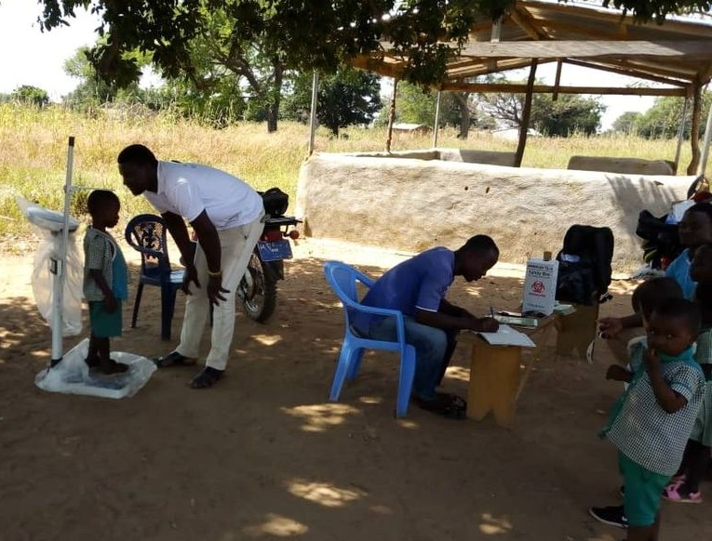
Conclusions & Recommendations
The absence of regular health education and screenings implies that students and educators may lack crucial information on maintaining physical health, which could lead to poor health practices and preventable health issues. Also, health issues may go undetected and unmanaged, potentially exacerbating health problems that could otherwise be addressed early.
STRATEGY
Establish regular health education and screening programs in collaboration with local healthcare providers to ensure early detection and management of health issues, thereby promoting better long-term health for students and educators.

Slide 18
Conclusions and Recommendations
The inadequacy of measures in place to handle health emergencies indicates a vulnerability in the school's ability to respond effectively to health crises, which could compromise the safety and well-being of the school community.
STRATEGY
Develop and implement health emergency plans, including first aid training for staff and students and ensuring that schools are equipped with necessary medical supplies and facilities, to enhance preparedness and response to health emergencies.

Slide 19
Conclusions and Recommendations
The gaps in mental wellness support for both teachers and students could lead to unaddressed mental health challenges which can decreased their overall well-being.
STRATEGY
Implement mental health support programs, including accessible counselling services, mental health awareness initiatives, and measures to reduce stigma and encourage seeking help, along with strategies to manage and balance workload effectively.

Slide 20
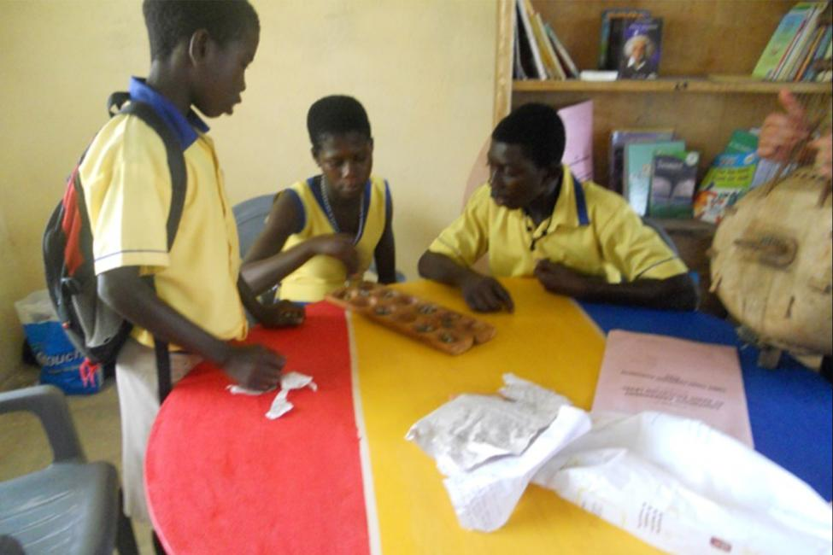
Conclusions and Recommendations
The significant lack of access to resources and programs for emotional development, coupled with insufficient support during emotional difficulties, suggests that their overall emotional wellness is compromised. This lack of support can hinder their ability to effectively manage emotions and maintain emotional safety, which are critical for their mental health and academic success.
STRATEGY
Foster a school culture that encourages open communication and emotional expression. This can be achieved through regular workshops, peer mentoring, and creating safe spaces where students and teachers feel comfortable sharing their feelings.

Slide 21
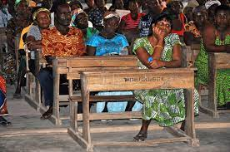
Conclusions and Recommendations
The findings suggest that the most critical factors influencing the effectiveness of wellness practices among students and educators in the North East Region of Ghana are the availability of resources and cultural and community influences.
STRATEGIES
Schools should partner with local and international NGOs, government bodies, and private sectors to secure funding and resources.
Also, organize community meetings and workshops to educate parents and community members about the benefits of wellness practices for students and educators.

Slide 22
Wellness for Educators in Ghana
Mental/Emotional
Teachers working in rural areas experience stress and limited access to support services.
Educators and Students have limited resources to promote emotional development
Social
Teachers have a positive sense of community and support the wellbeing of one another.
However, students were neutral with feeling a sense of belonging.

Slide 23
Benefits of Wellness Program
Promotes Mental Health Wellness
Improves Physical Health
Increases Productivity and Focus
Fosters Better Relationships
Increases Self-Esteem
Prevents Burnout
Mindfulness

Slide 24
Mindfulness
Inhale/Exhale

Slide 25
Wellness and Self-Care for Educators
Introduction
Quantitative Study
Key Findings
Conclusions and Recommendations
Building Culture
Breathing Technique

Slide 26
Thank You
Contacts:
mpeterbraimah@gmail.com
ebrown.davis@gmail.com

